Slide 1
GITHUB
SUBMITTED BY : ASMIT
BRANCH : AIML
ROLL NO : 2322811
SUBMITTED To : Mr. DEVASHISH SIR

Slide 2
Steps to make a GitHub account
Go to GitHub: Open your web browser and navigate to GitHub's website.
Sign Up: On the GitHub homepage, you'll see a "Sign Up" option , Click on it.
Enter Your Information:
Username : Choose a username that will be your unique identifier on GitHub. GitHub will prompt you to choose a different one if your username is already taken.
Email Address : Enter your email address. This will be used for account-related notifications and communication from GitHub.
Password : Choose a strong password to secure your account.
4. Verify Your Account:
GitHub will send a verification email to your email address. verify your email to confirm your email address.
5. Set Up Your Profile:
Once signed up, you can customize your profile by adding a profile picture, bio, and other details. This helps others to identify you and learn about your interests.

Slide 3

HOME PAGE

Slide 4
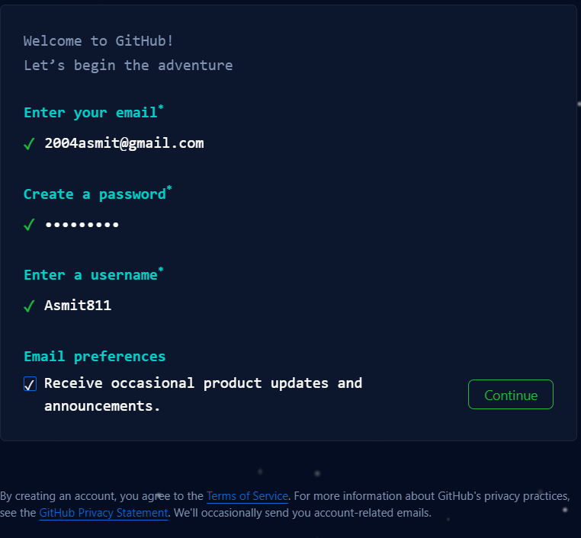
INTERFACE

Slide 5
SETUP
Create a GitHub account :
https://github.com/signup > enter details > confirm email
Install Git :
Download and install Git from git-scm.com.
Check Git installation :
On terminal (mac) or shell (window) or VS code (after VS code installation>tools menu>view>terminal
Install code editor (VS code) :
https://code.visualstudio.com

Slide 6
GIT COMMANDS
INITIALIZE :
Initialize a new git repositiory in working directory
ADD :
Add changes in working directory to staging area
COMMIT :
Save changes from staging area to local repository in Git
PUSH :
Upload local repository content to a remote. Eg. GitHub
CLONE :
Clone a repository from GitHub onto a local machine

Slide 7
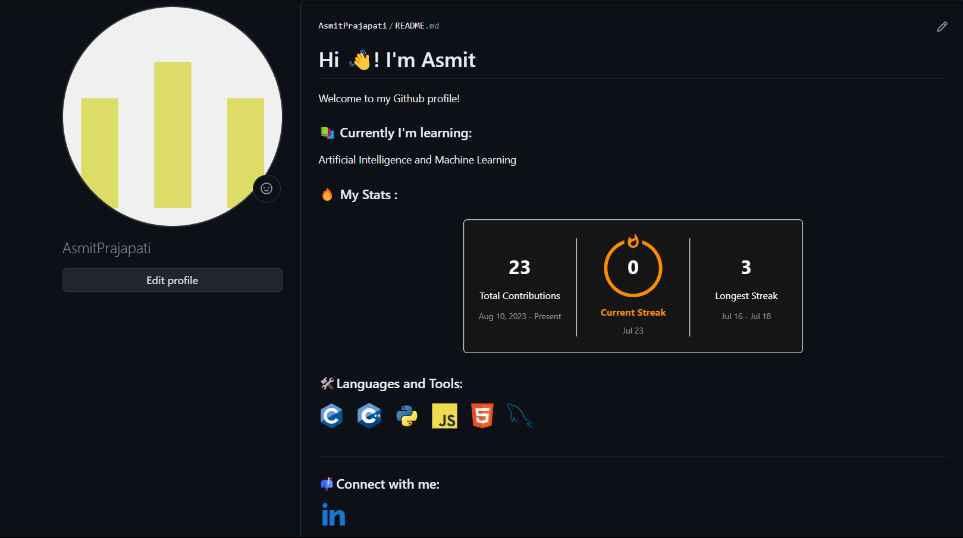
My GitHub Profile

Slide 8


